Slide 1
Event Handling in javascript
By: Dr.Parul Madan(cse)
geu

Slide 2
What is an Event ?
JavaScript's interaction with HTML is handled through events that occur when the user or the browser manipulates a page.
When the page loads, it is called an event. When the user clicks a button, that click too is an event. Other examples include events like pressing any key, closing a window, resizing a window, etc.
Developers can use these events to execute JavaScript coded responses, which cause buttons to close windows, messages to be displayed to users, data to be validated, and virtually any other type of response imaginable.

Slide 3
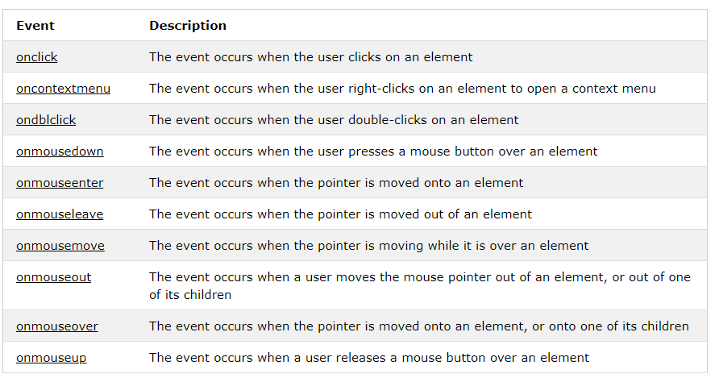
Types of Mouse Events

Slide 4
Mouse Event Properties
clientX: | Returns the horizontal coordinate of the mouse pointer, relative to the current window, when the mouse event was triggered.
clientY: | Returns the vertical coordinate of the mouse pointer, relative to the current window, when the mouse event was triggered.
movementX: | Returns the horizontal coordinate of the mouse pointer relative to the position of the last mousemove event.
movementY | Returns the vertical coordinate of the mouse pointer relative to the position of the last mousemove event
screenX | Returns the horizontal coordinate of the mouse pointer, relative to the screen, when an event was triggered
screenY | Returns the vertical coordinate of the mouse pointer, relative to the screen, when an event was triggered

Slide 5
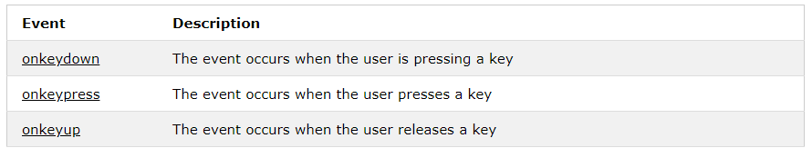
Types of Key Events

Slide 6
<!DOCTYPE html>
<html>
<body>
<h2 onclick="showCoords(event)">Click this heading to get the x (horizontal) and y (vertical) coordinates of the mouse pointer when it was clicked.</h2>
<p><strong>Tip:</strong> Try to click different places in the heading.</p>
<p id="demo"></p>
<script>
function showCoords(event) {
var x = event.clientX;
var y = event.clientY;
var coords = "X coords: " + x + ", Y coords: " + y;
document.getElementById("demo").innerHTML = coords;
}
</script>
</body>
</html>

